Slide 1
Stacks and Queues
CS163 Lab 3

Slide 2

Stacks

Slide 3
Stack Operations (LIFO)
void push(data) - Put new data on top of the stack
void pop() - Remove the data on the top of the stack
peek (data &) - Retrieve the data on top of the stack (next data to be popped)
is_empty() - Returns true if the stack is empty, false if it's not empty

Slide 4
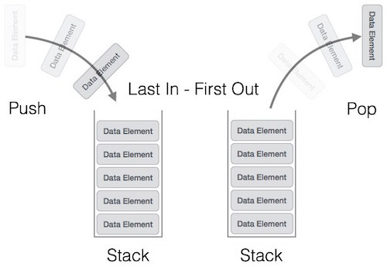
Stack Operations

Slide 5

Queues

Slide 6
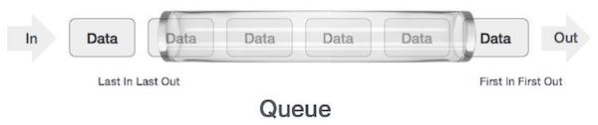
Queue Operations (FIFO)
void enqueue(data) - Put new data in the back of the queue
void dequeue() - Remove the data at the front of the queue
peek (data &) - Retrieve the data in the front of the queue (next data to be dequeued)
is_empty() - Returns true if the queue is empty, false if it's not empty

Slide 7
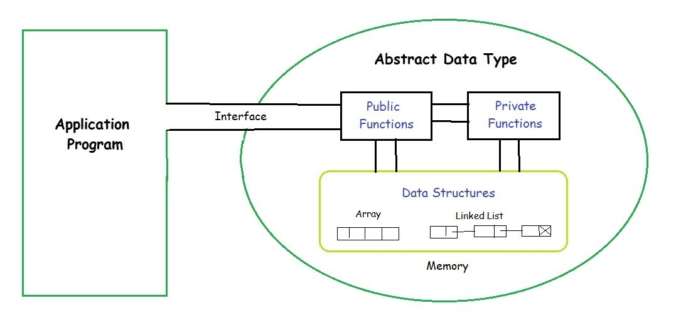
ADT vs Data Structure and the "Wall"

Slide 8
ADT vs Data Structure and the "Wall"
ADT is the conceptual representation, model (Stack, Queue, List, etc)
Data structures is a physical representation of a collection of data (Array, LLL)
We can implement an ADT with different data structures (some better than others) BUT the functionality of the ADT will not change!
We should be able to swap out a different data structure in the implementation and the client program wouldn't have to change.
The "Wall" is what separates the client program (main) from the implementation of the ADT.
Don't use nodes in main!
Main should get user input/data and pass it over the "Wall" to the ADT implementation.

Slide 9

What Data Structure Should We Use For a Stack?

Slide 10
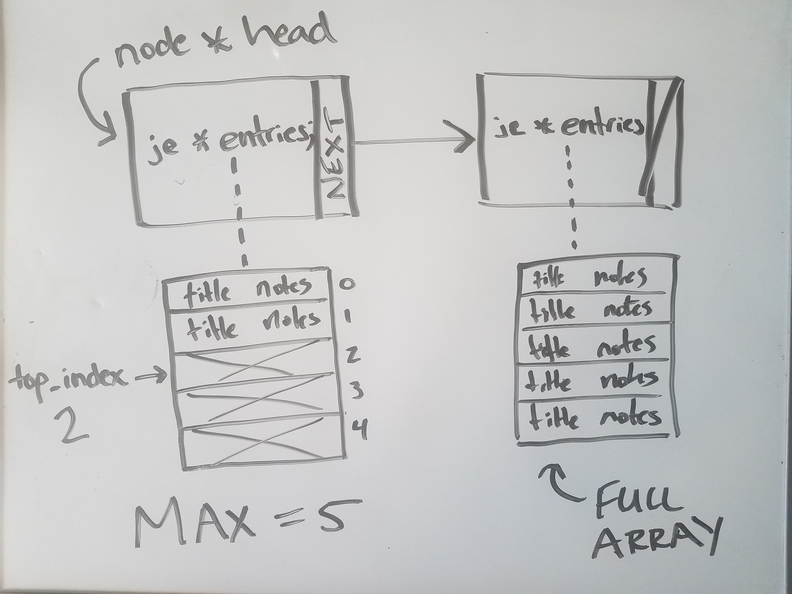
Linear Linked List of Dynamic Arrays

Slide 11

What Data Structure Should We Use For a Queue?

Slide 12
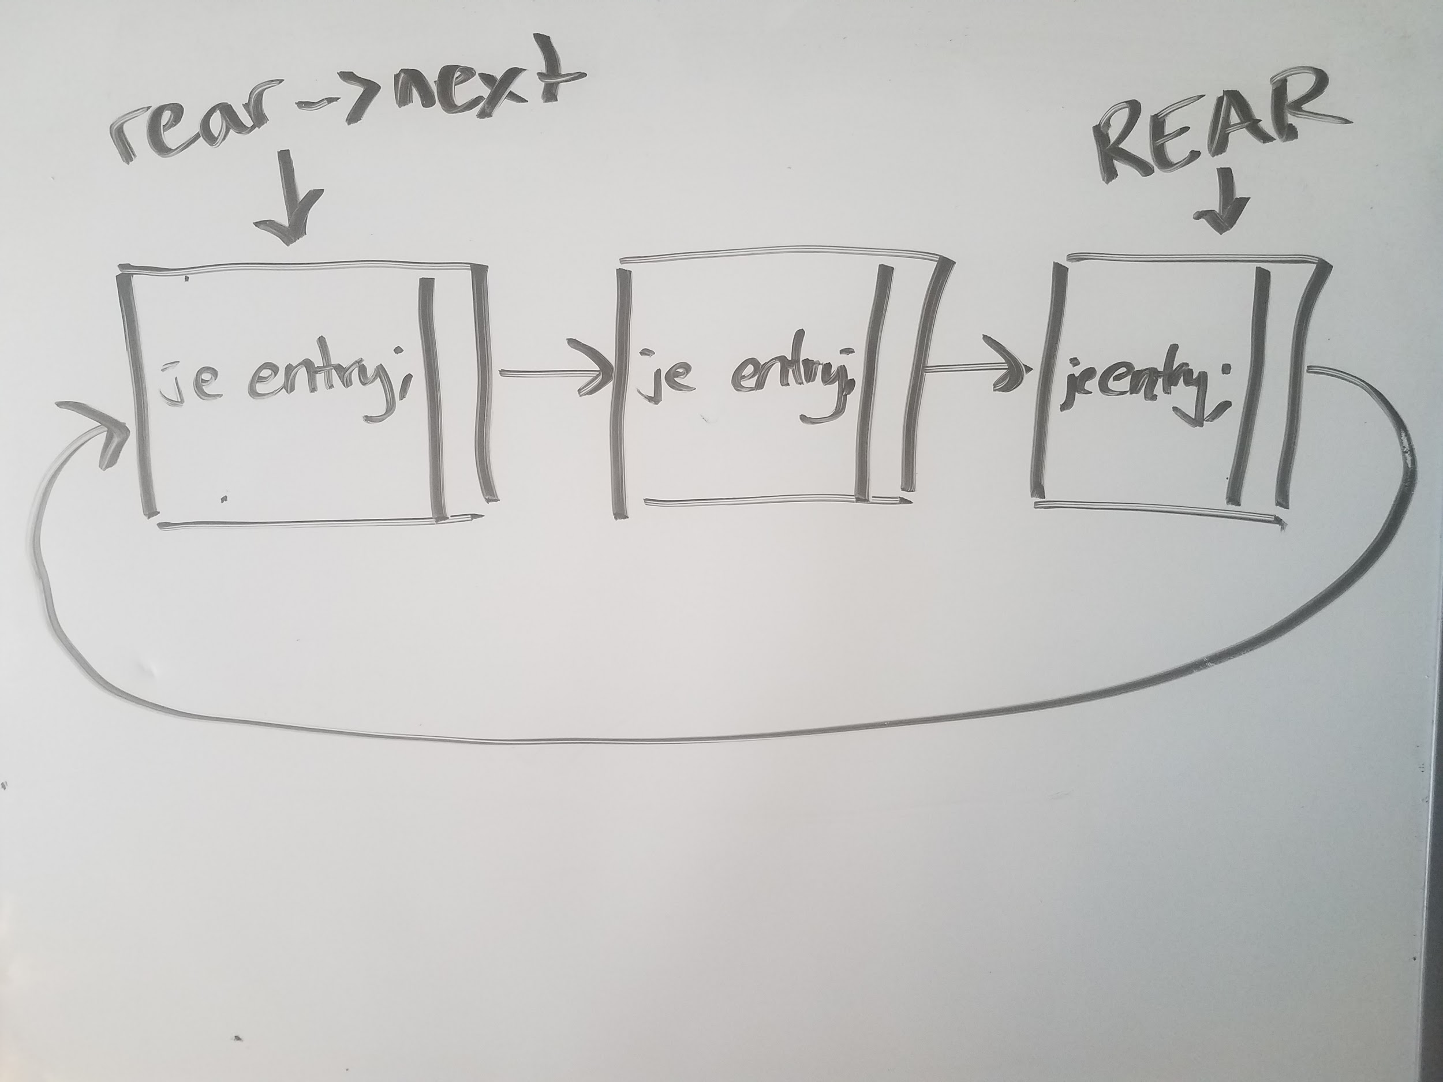
Circular Linked List

Slide 13
A Note on Memory Management
How do I allocate my journal entry array with a size of MAX? (journal_entry * entries)

Slide 14
A Note on Memory Management
How do I allocate my journal entry array with a size of MAX? (journal_entry * entries)
entries = new journal_entry[MAX];
How do I deallocate my journal entry array?

Slide 15
A Note on Memory Management
How do I allocate my journal entry array with a size of MAX? (journal_entry * entries)
entries = new journal_entry[MAX];
How do I deallocate my journal entry array?
delete [] entries; (don't forget [] !)

